Slide 1

Safe Habour Youth
Team Members- Aadit Shah, Sushma Arun, Vinay Sathe, Sohni Rais

Slide 2
About US
Safe Harbour Youth is a transformative online initiative designed to create a safe and confidential space for youth. It features three core components: the Youth Connect Portal, the NGO Response Center, and the Youth Empowerment Hub.
The Youth Connect Portal allows young individuals to seek support and report instances of abuse or violence, connecting them with trusted NGOs committed to their well-being. The NGO Response Center serves as a crucial hub where partner organizations diligently address and investigate these reports, ensuring swift and empathetic resolutions.
Finally, the Youth Empowerment Hub offers a repository of resources, educational content, and articles to empower youth by increasing awareness about violence and abuse, and providing tools for resilience and self-advocacy. Together, these platforms foster a community of support, enlightenment, and empowerment for young individuals facing challenges.

Slide 3
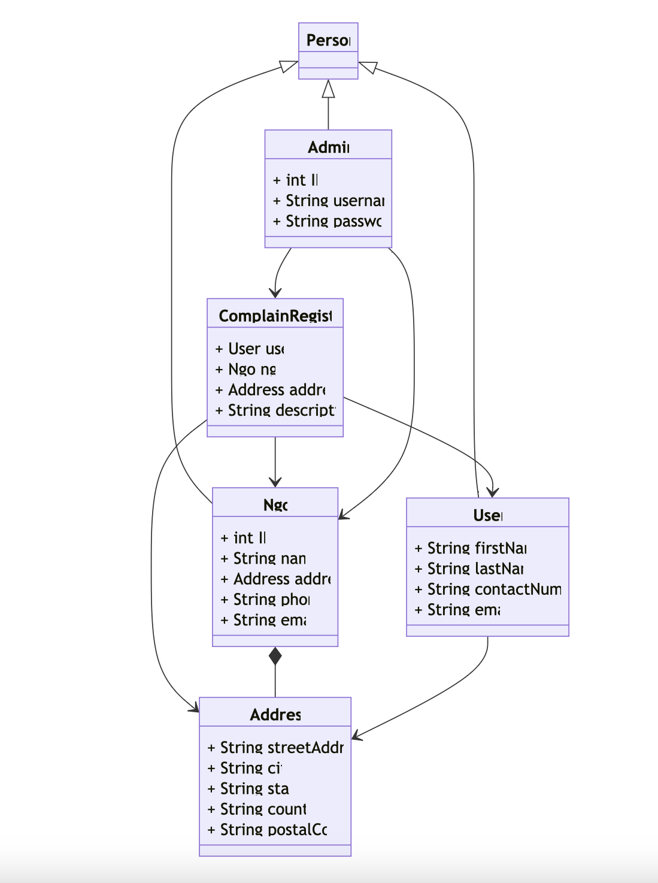
Object Model

Slide 4
WorkFlow
Welcome to our Youth Connect Portal, where we facilitate a seamless interaction between youth seeking help and our partner NGOs committed to providing support. Here's a step-by-step guide to how the process flows on our website:
Filing a Complaint: When a user decides to file a complaint, they will complete a form detailing their experience of abuse or violence. At this stage, the user selects the NGO they wish to handle their case. Upon submission, the user will receive a unique complaint ID, which helps in tracking the status of the complaint.
NGO Registration and Login: Before an NGO can respond to complaints, they must first register on our site. The registration request is then reviewed and approved by the site administrator. Once approved, NGOs can log into the portal.
NGO Dashboard: Upon logging in, the NGO is directed to their personalized dashboard. This dashboard displays the number of complaints assigned to them, along with a graphical representation showing the status of each complaint: pending, in process, or completed.
Complaint Management: NGOs can interact with the user through the dashboard. They have the ability to update the status of a complaint from 'pending' to 'in process' as they engage with the user. Once the issue is resolved, and communication is deemed complete, the status can be updated to 'completed.'
Admin Access: The admin has the ability to log in directly to oversee the entire system. The admin dashboard provides a comprehensive view, including the number of registered NGOs and a graph depicting the overall number of complaints across various stages.

Slide 5
Key Features
User Complaint Form
Track Complaints
NGO Authorization
Pie Chart Implementation
Stripe Payment Integration for Donation
WhatsApp message integration
Youth Tube Video Embedded
Responsive Design

Slide 6
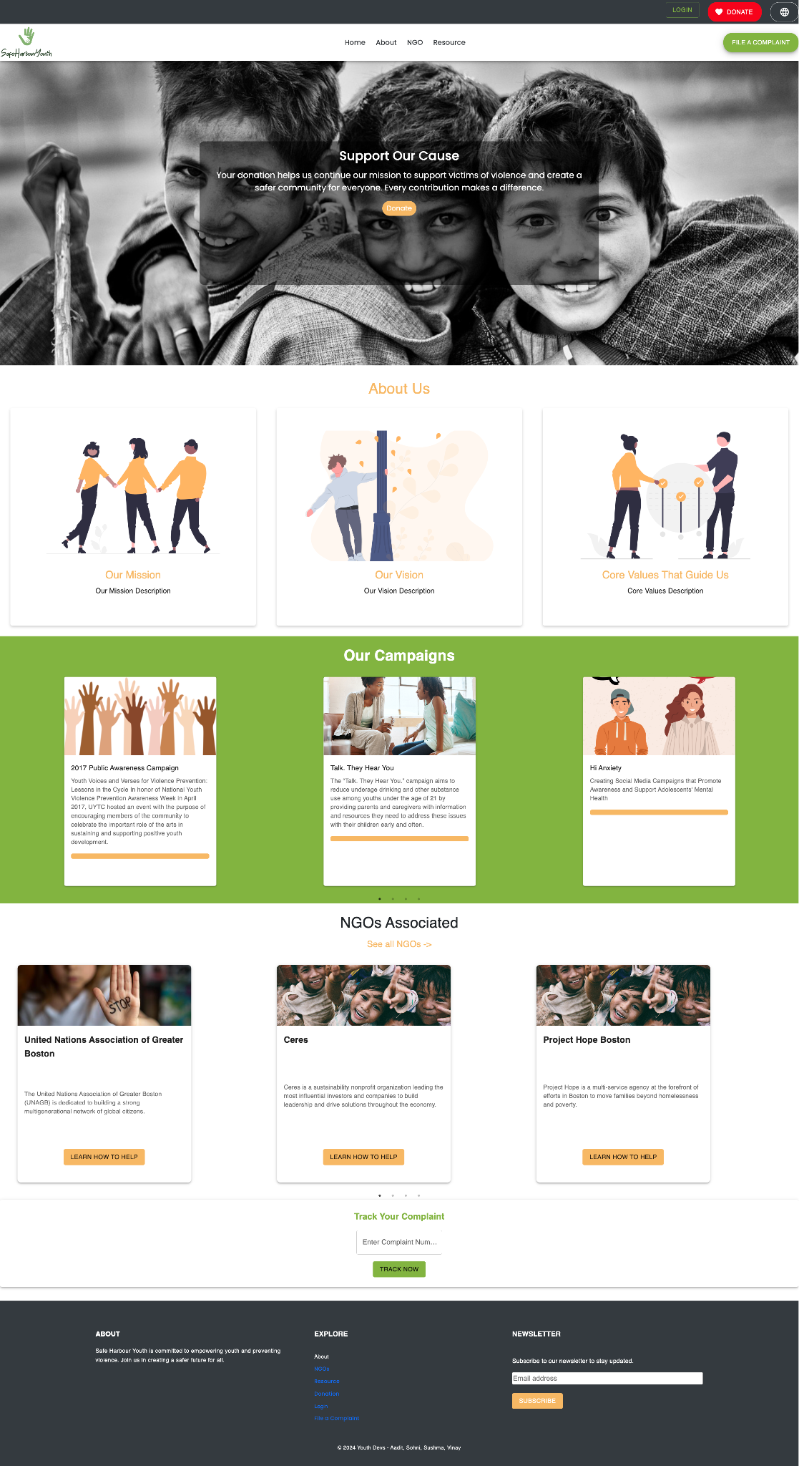
Home Page

Slide 7
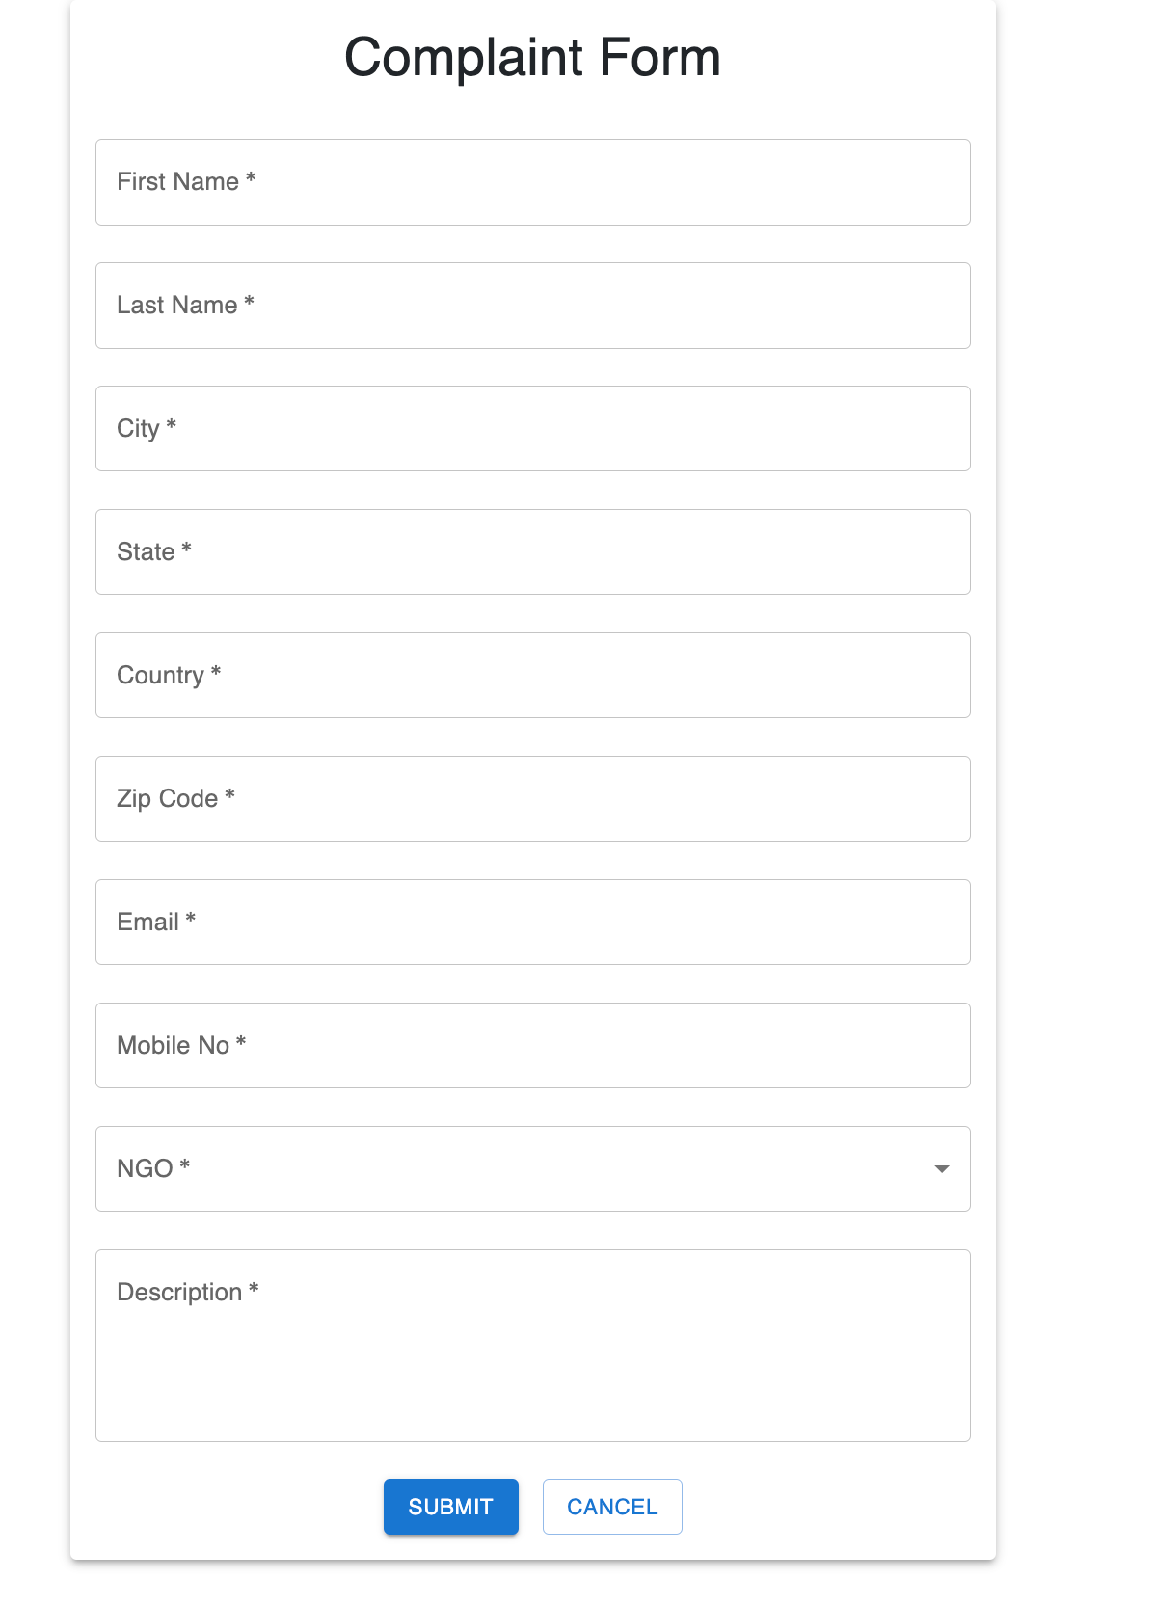
Complaint Form

Slide 8
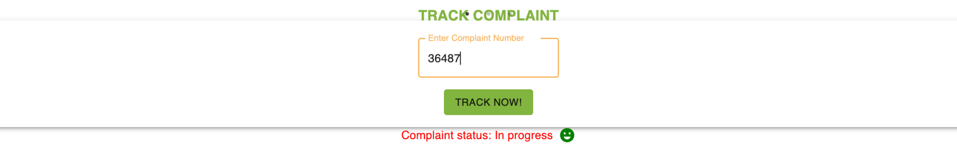
Track Complaint

Slide 9
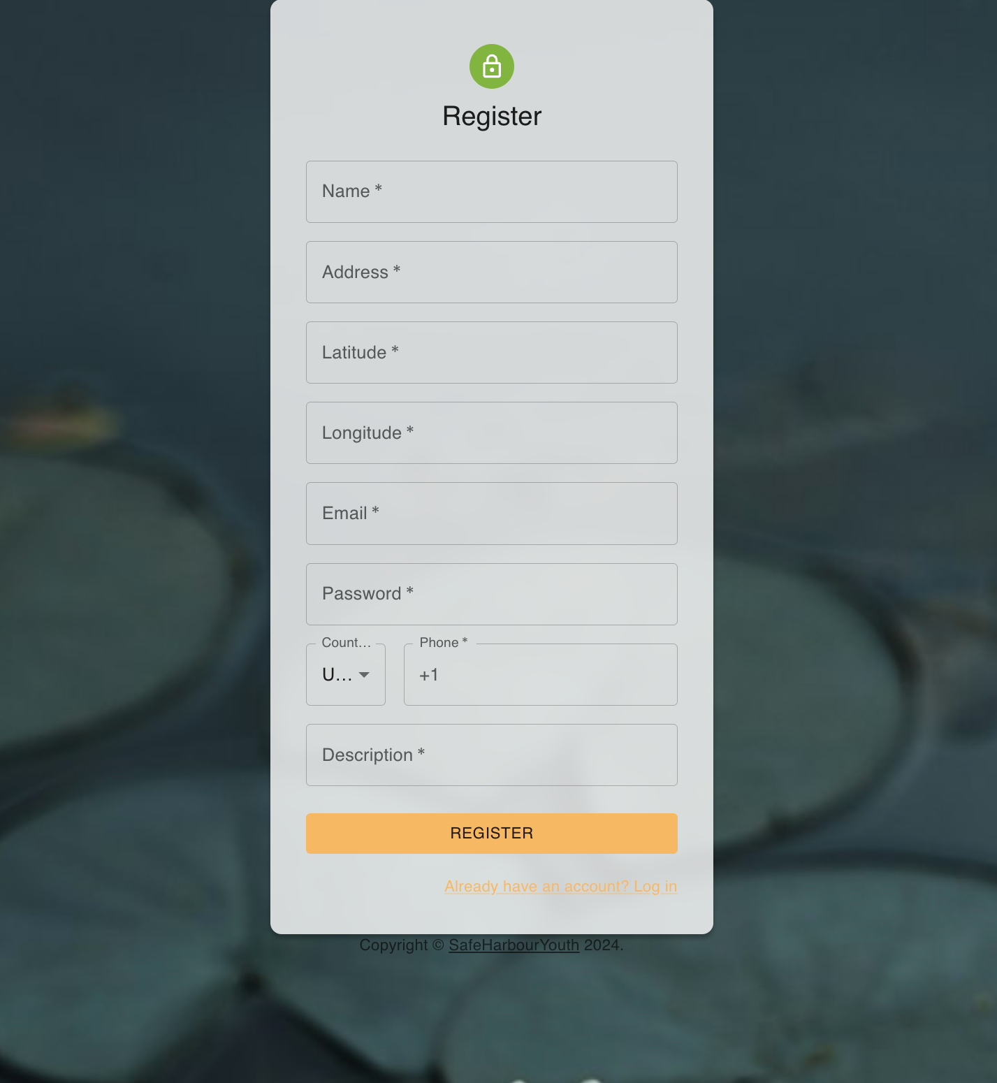
Registration

Slide 10
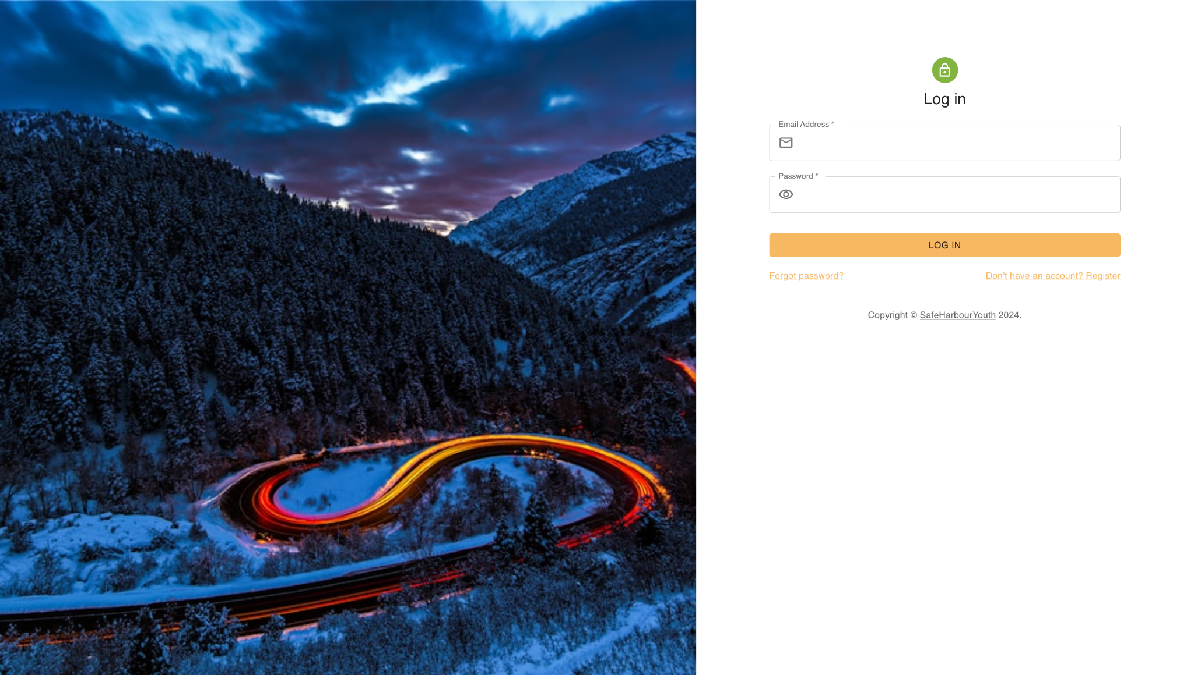
Login

Slide 11
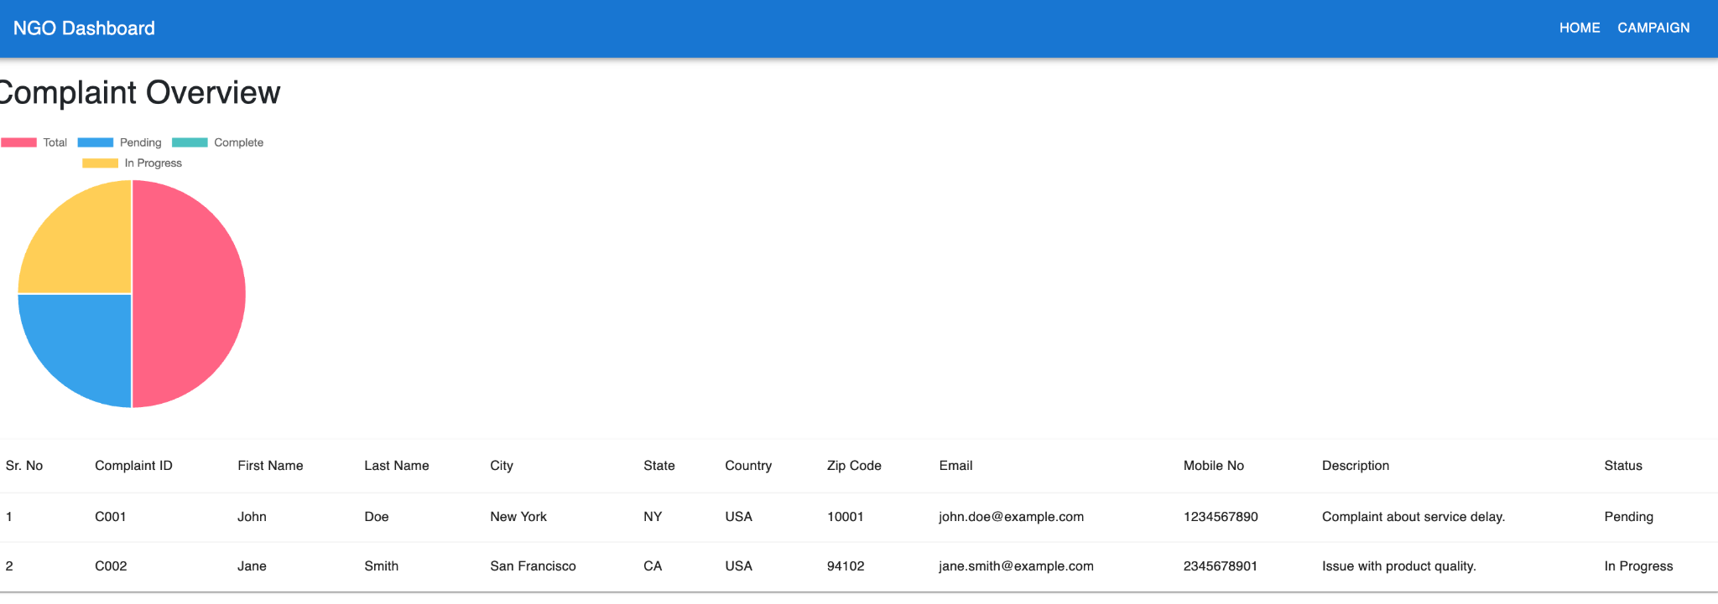
NGO Dashboard

Slide 12
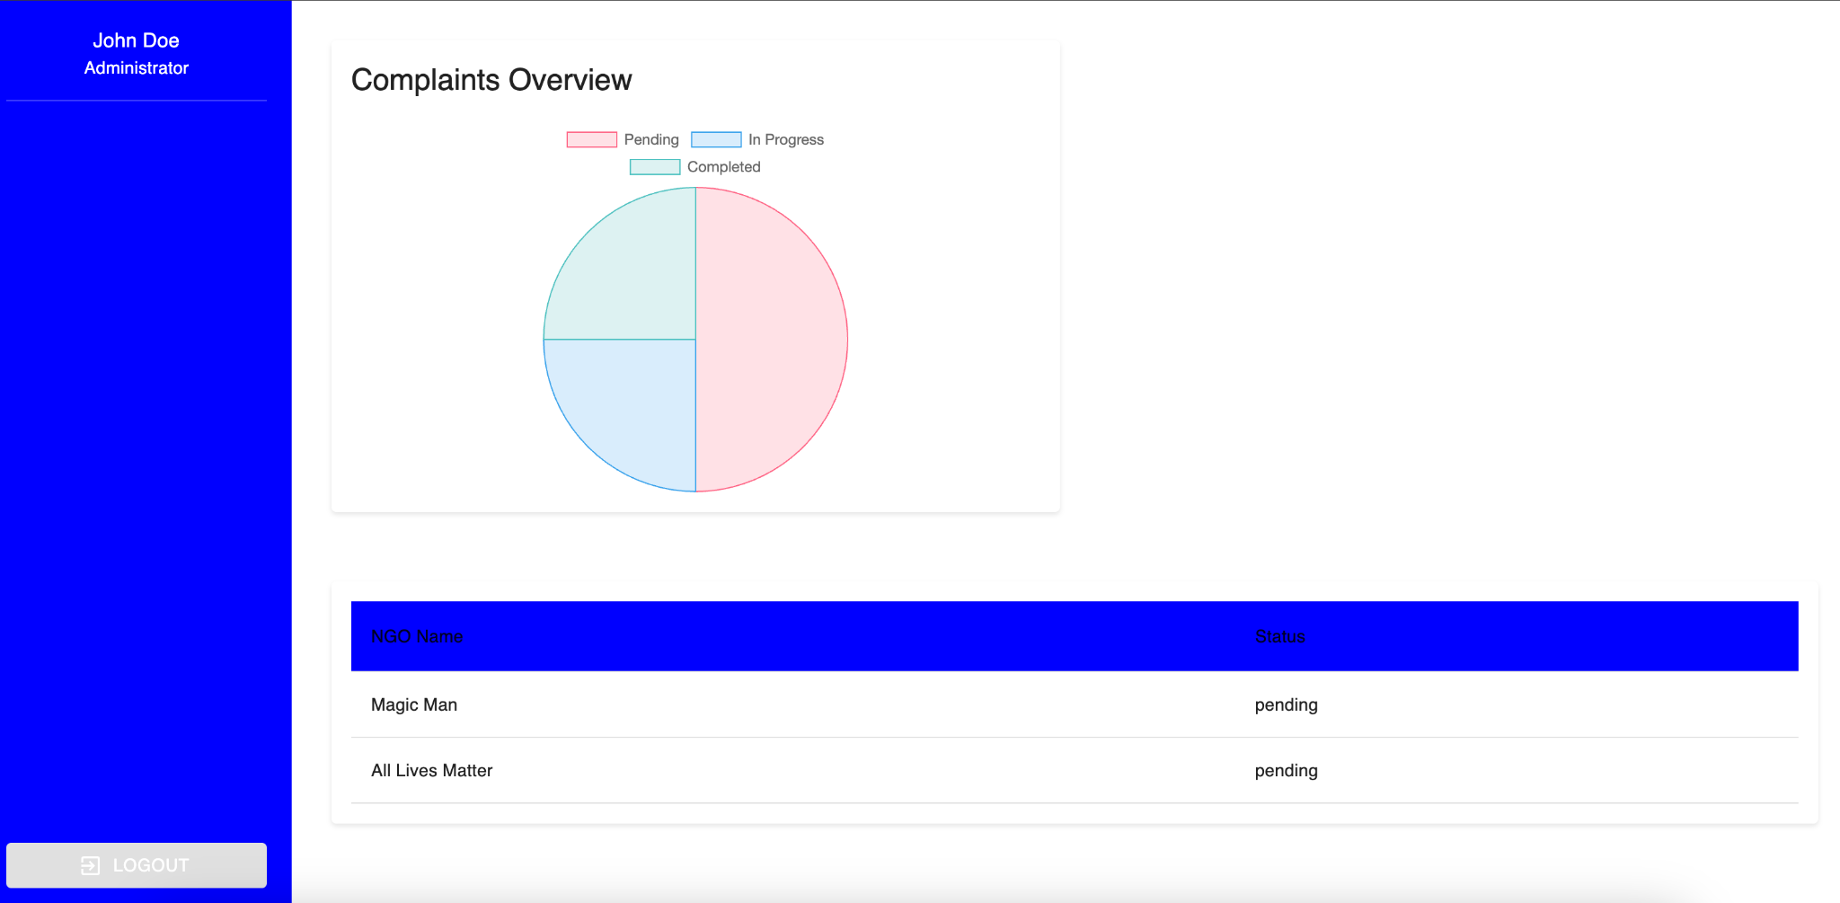
Admin Dashboard

Slide 13
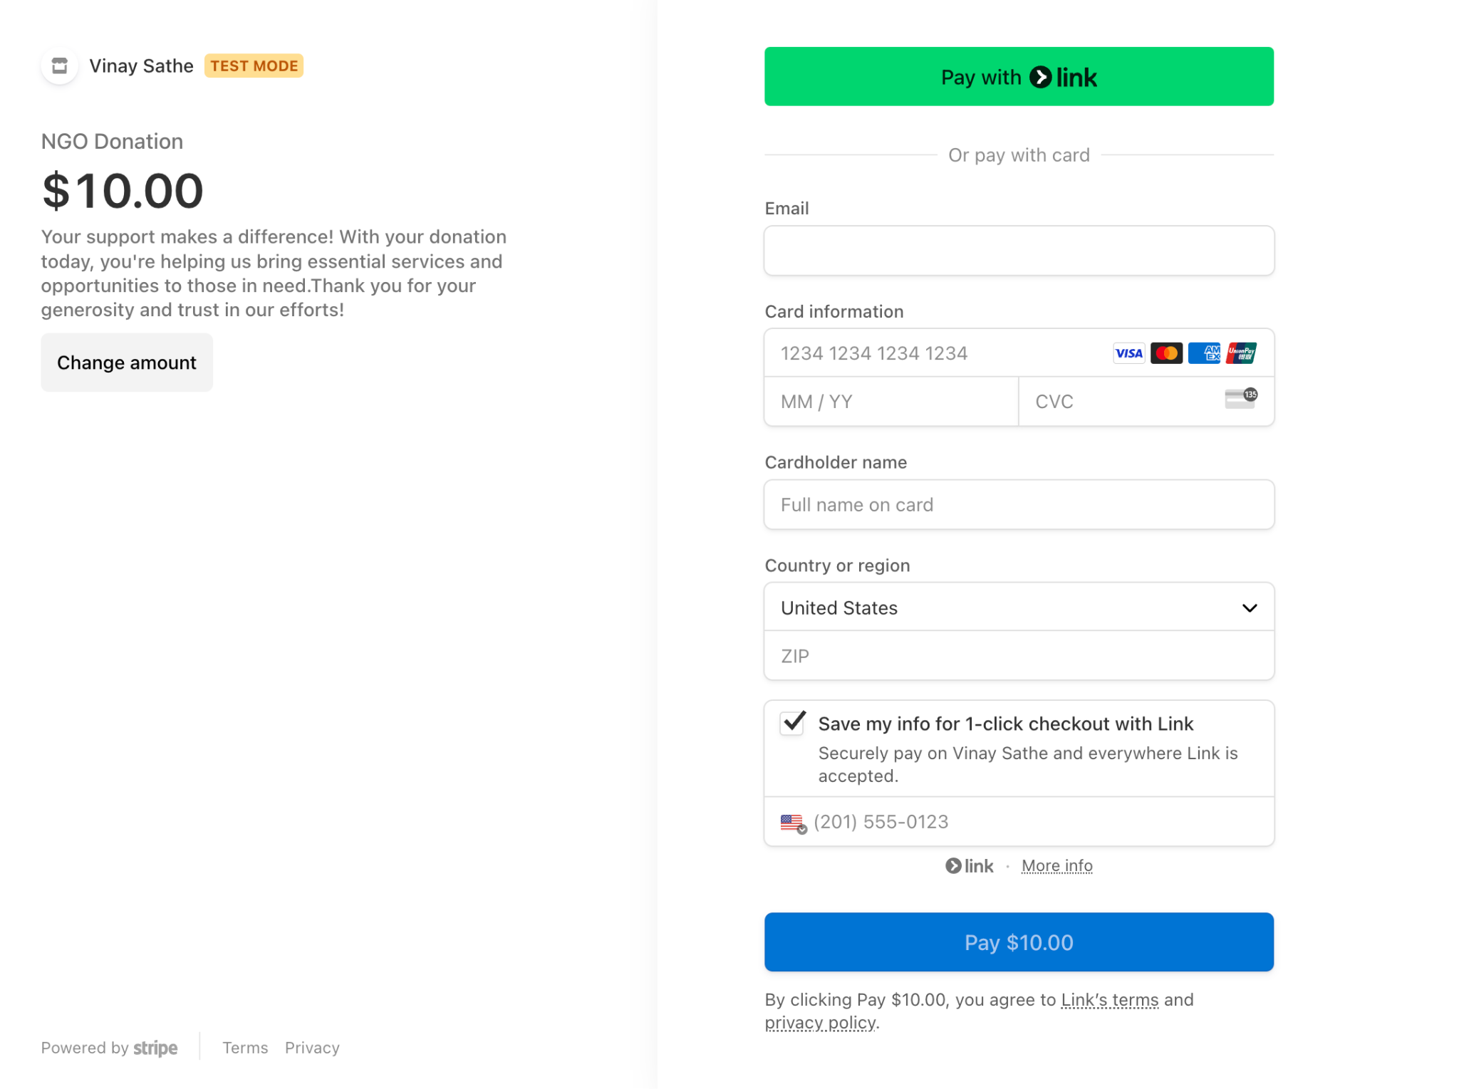
Donation

Slide 14
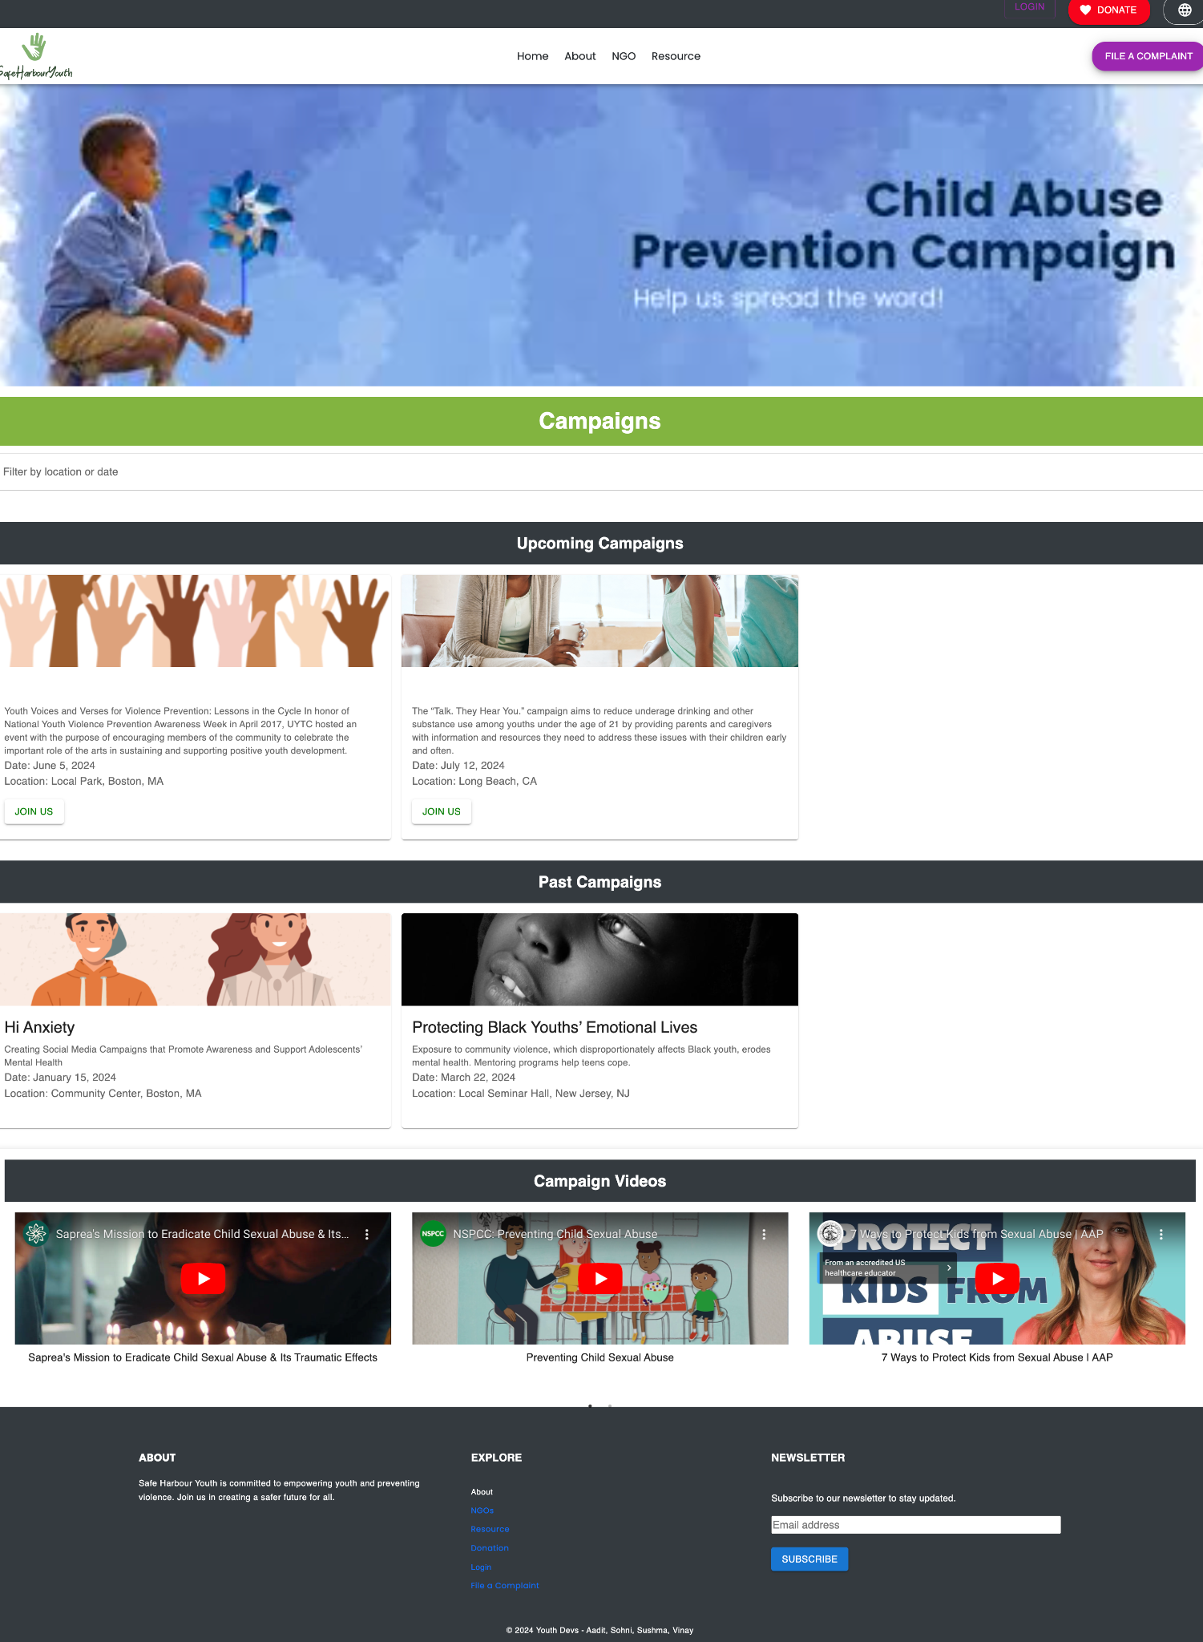
Video Embedded

Slide 15
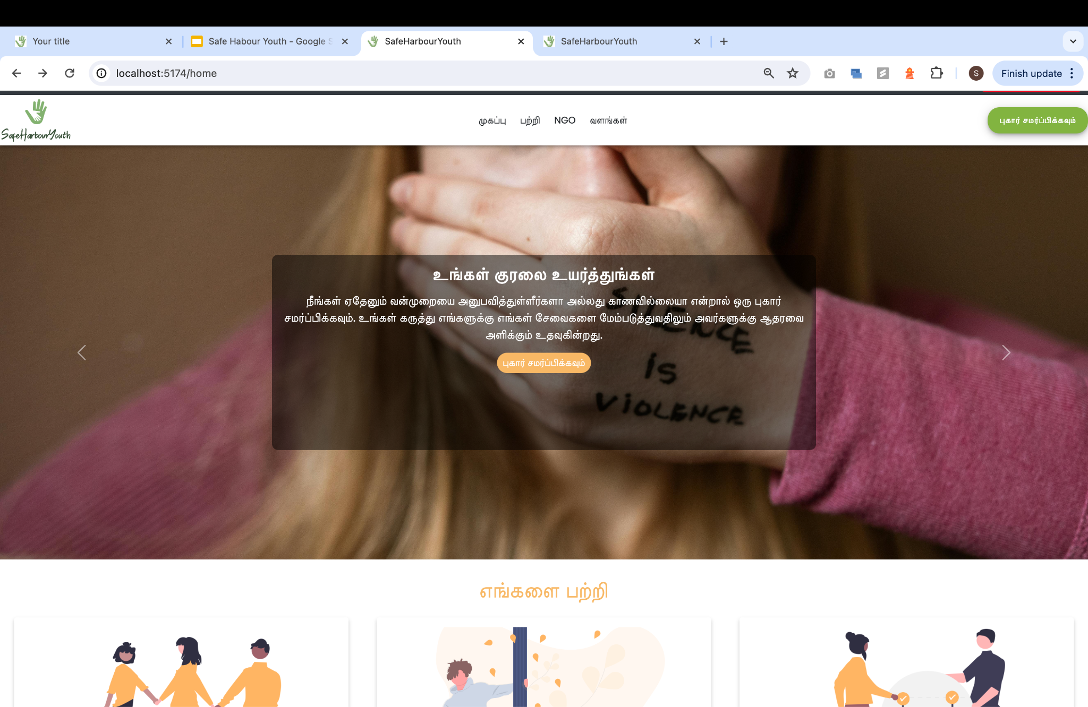
Language Translation

Slide 16
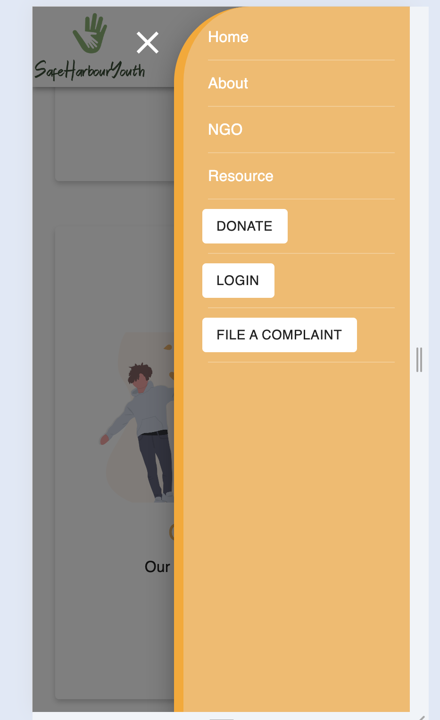
Responsive Design

Slide 17
Thank You!

